Slide 1
Random Forest
Technical Sharing Meeting
2022/10/06

Slide 2
Index
Random Forest
Review of Decision Tree
Model Accuracy - Bias and Variance (Motivation of Random Forest)
Introduction of Ensemble Method (Random Forest is a member of it)
How does Random Forest Work?
Key hyperparameters of Random Forest
Case Study of Random Forest with Python

Slide 3
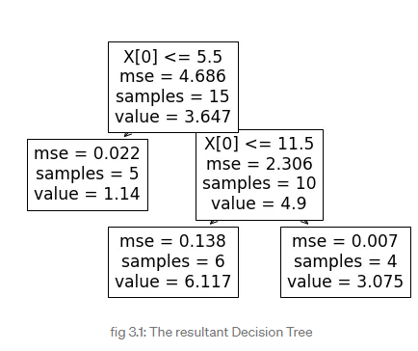
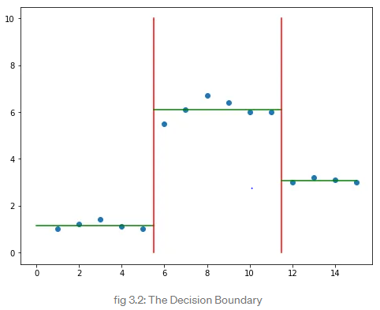
Review of Decision Tree
Supervised machine learning algorithm for Classification and Regression
Classification for labelling
Regression for predicting values
Cluster data points using linear decision boundaries into same class
using true or false answers to certain questions
Split the feature to improve purity/homogeneity using different measures (e.g. Gini, MSE, Entropy)
Once the tree is constructed, go down the tree using the conditions at each node to arrive prediction
Example: Regression Tree, splitting using MSE

Slide 4
Review of Decision Tree (Overfitting / High Variance)
Decision Tree prone to Overfitting while many leaves are created
if you imagine a very large tree, it can basically adjust its predictions to every single input.
Consider you wanted to predict the outcome of a soccer game. A decision tree could make decisions like:
1. player X is on the field AND
2. team A has a home game AND
3. the weather is sunny AND
4. the number of attending fans >= 26000 AND
5. it is past 3pm
THEN team A wins.
Now, if you make a small change, e.g. set the number of attending fans to 25999, a decision tree might give you a completely different answer (because the game now doesn't meet the 4th condition).
It has high variance as it is very sensitive to (small) changes in the training data (and therefore an inability to generalize to new data).

Slide 5
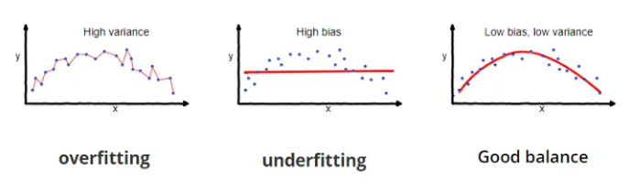
Model Accuracy
Lower Prediction Error = Increase Model Accuracy
The prediction error for any machine learning algorithm can be broken down into three parts:
1. Bias Error
- difference between the average prediction of our model and the correct value which we are trying to predict
2. Variance Error
- variability of model prediction for a given data point or a value
3. Irreducible Error
- the error that can’t be reduced by creating good models

Slide 6
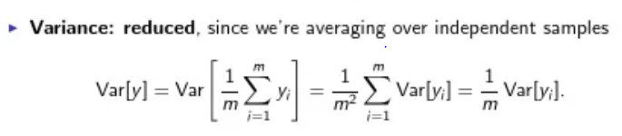
How to tackle the variance issue?
Random Forests use the output of multiple Decision Trees (Ensemble Method), combining them into a single voting system that helps to mitigate some of their immediate problems.
Intuitively, it’s like Wisdom of the Crowds, average decision of a group is often better than the decision of any one individual.
However, it’s important for every individual to be uncorrelated!

Slide 7
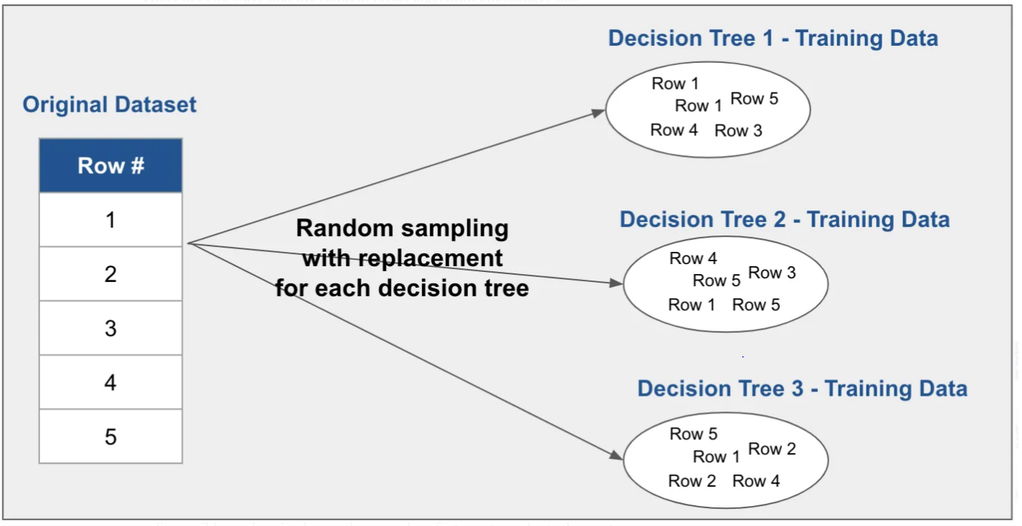
How to make trees to be uncorrelated? (1)
First, each decision tree within a random forest is trained on a different subset of the data. This is made possible by a sampling process known as “random sampling with replacement”, where records are selected at random but not removed from the initial dataset.

Slide 8
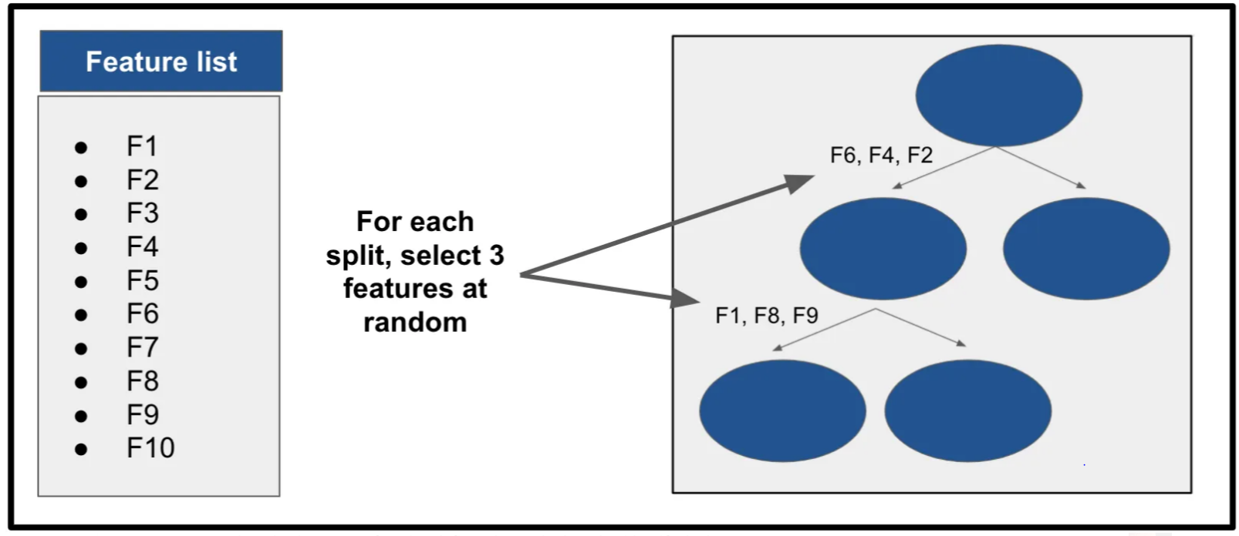
How to make trees to be uncorrelated? (2)
Secondly, the random forest algorithm also creates diversity by selecting a random subset of the full list of features at every split in each decision tree. The size of that subset is a flexible parameter, but a common choice is to use the square root of the total number of features (this is what the scikit-learn implementation of the random forest classifier uses by default).

Slide 9
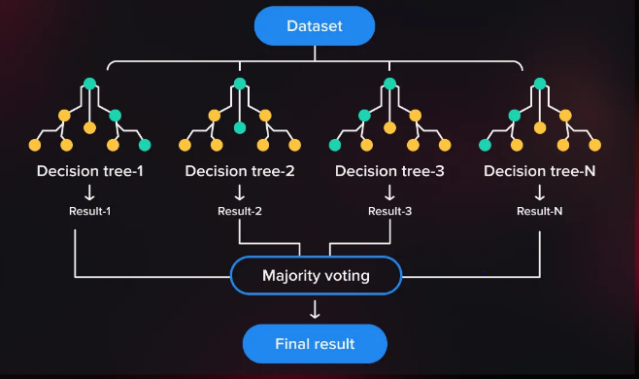
How does Random Forest Work?
So in random forest, we end up with trees that are not only trained on different sets of data (also known as bagging) but also use different features to make decisions. And that, creates uncorrelated trees that buffer and protect each other from their errors.
To Sum Up:
1. Split the dataset into subsets
2. Train decision trees
3. Aggregate the results
- Voting for classification
- Averaging for regression
Example – Classification RF and voting

Slide 10
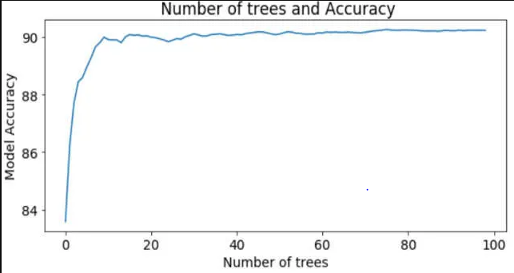
Key hyperparameters of Random Forest
There are two additional hyperparameters that apply specifically to random forests.
1. Number of estimators
defines how many trees are included in the forest. While increasing the number of trees is unlikely to hurt accuracy, there tends to be diminishing returns. And, of course, the more estimators, the longer it takes to train the model.
2. Max features
defines how many features are available at each split in each tree. As mentioned above, a common default is the square root of the total number of features.

Slide 11
Case Study of Random Forest with Python
House Price Predict: Decision Tree, Random Forest
https://www.kaggle.com/code/subhradeep88/house-price-predict-decision-tree-random-forest/notebook
Predict the overall health of an individual
https://github.com/WillKoehrsen/Machine-Learning-Projects/blob/master/Random%20Forest%20Tutorial.ipynb

